Slide 1
Automatic Document Scanner
Dasom Jang

Slide 2
Outline
Step 1
Find Edges with Canny Edge Detector
Step 2
Sort regions and select a valid one
Step 3
Adjust the valid region within the rectangular output shape
Step 4
Make it clear using adaptive thresholding and denoising

Slide 3
Step 1
Edge Detection
Input image
Resize
RGB to Gray
Gaussian Filtering
Canny Edge Detector
Edges

Slide 4
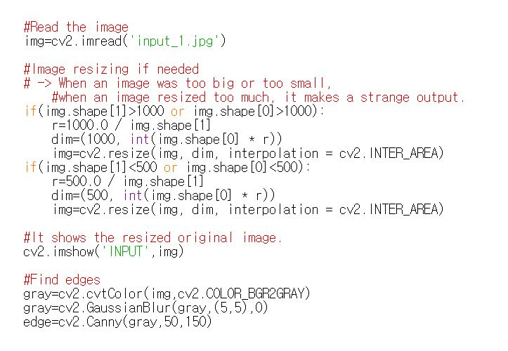
Step 1
Edge Detection

Slide 5
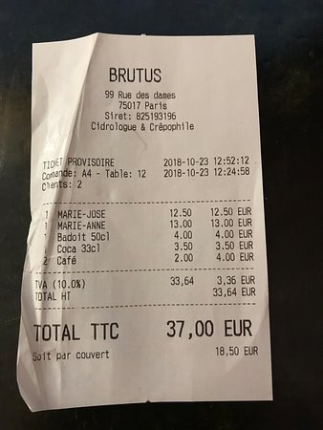
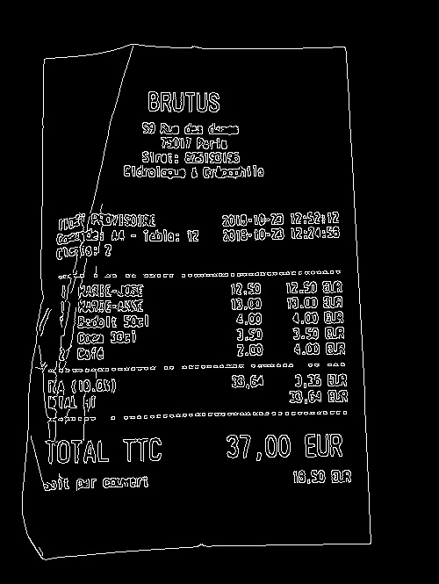
Step 1
Edge Detection

Slide 6
Step 2
Selecting a region
Edges
Find contours
Find maximum area
Valid Region

Slide 7
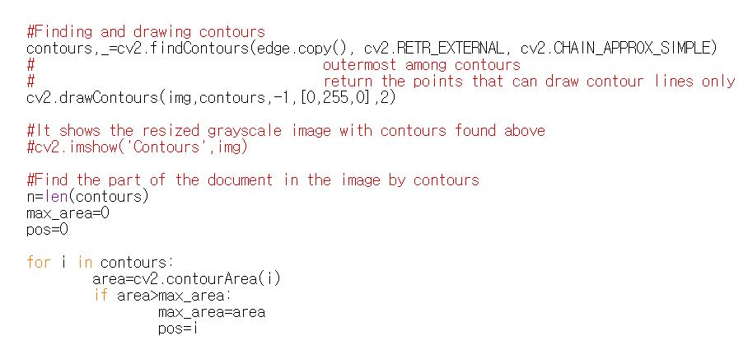
Step 2
Selecting a region

Slide 8
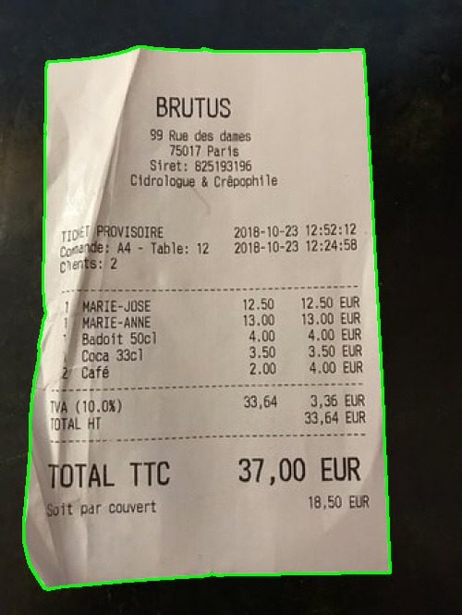
Step 2
Selecting a region

Slide 9
Step 3
Adjusting : using perspective matrix
Find vertex points
Valid region
Vertex points
Calculate perspective matrix
Output Size
Perspective matrix

Slide 10
Step 3
Adjusting : using perspective matrix
RGB to Gray
Perspective Matrix
Input Image
Fitted Image

Slide 11
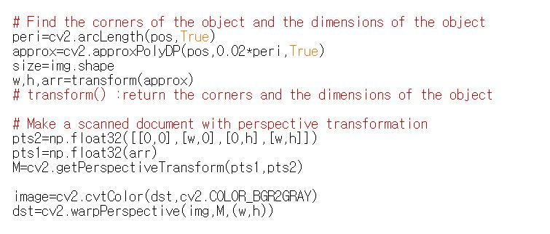
Step 3
Adjusting: using perspective matrix

Slide 12
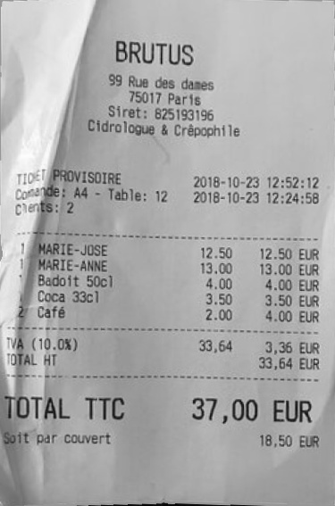
Step 3
Adjusting : using perspective matrix

Slide 13
Step 4
Revision : sharpening
Fitted Image
Unsharp Masking
resize
Output Image
→ grayscale output

Slide 14
Step 4
Revision : thresholding and softening
Fitted Image
Adaptive thresholding
Gaussian Blur
resize
Output Image
→ binary output

Slide 15
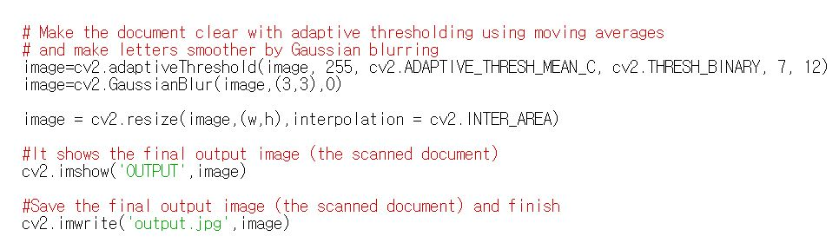
Step 4
Revision : thresholding and softening

Slide 16
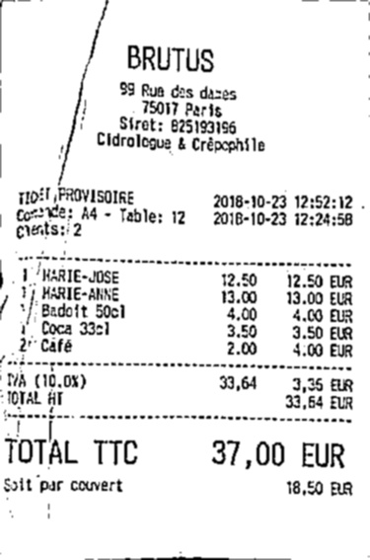
Step 4
Revision : thresholding and softening

Slide 17
Abstract
Input image
cvtColor()
GaussianBlur()
Canny()
findContours()
Grayscale image
Blurred image
Set of edges
Set of contours
Find maximum area
Size of document
warpPerspective()
Perspective matrix
getPerspectiveTransform()
Find vertex points
Document area contour
Location of vertices
Fitted image
adaptiveThreshold()
GaussianBlur()
Unsharp masking
Binary output
Grayscale output

Slide 18
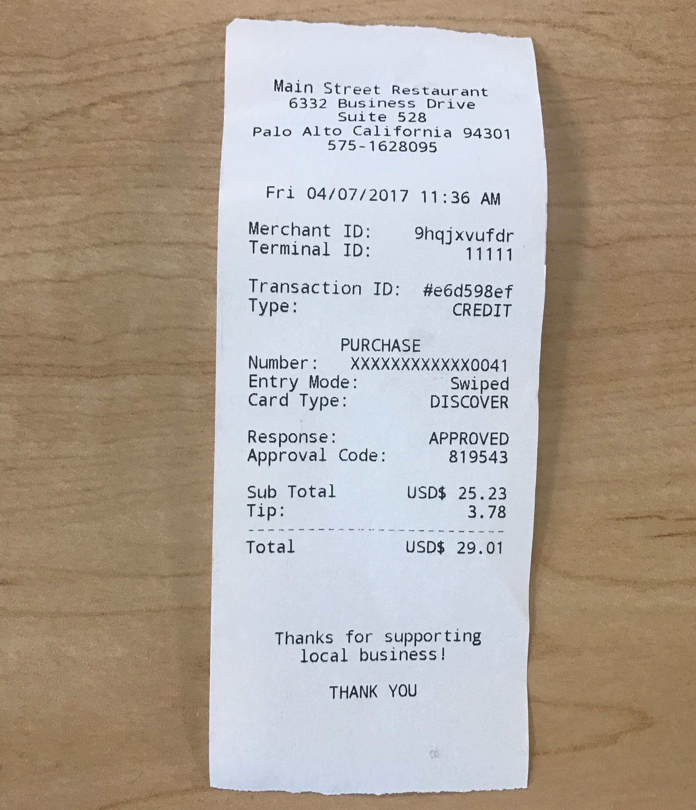
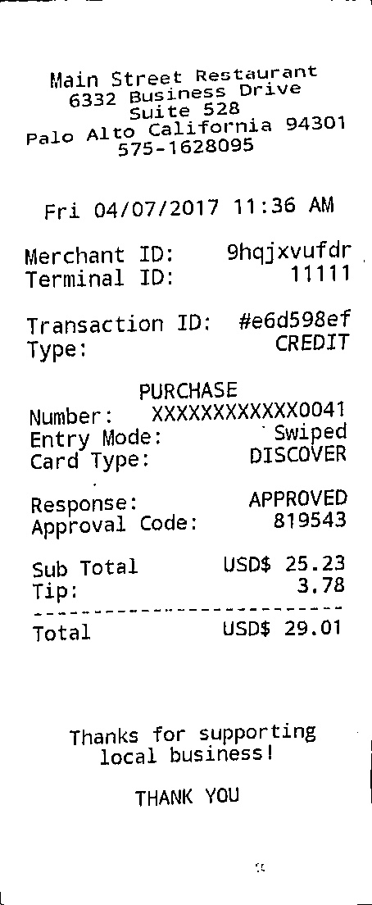
Results

Slide 19
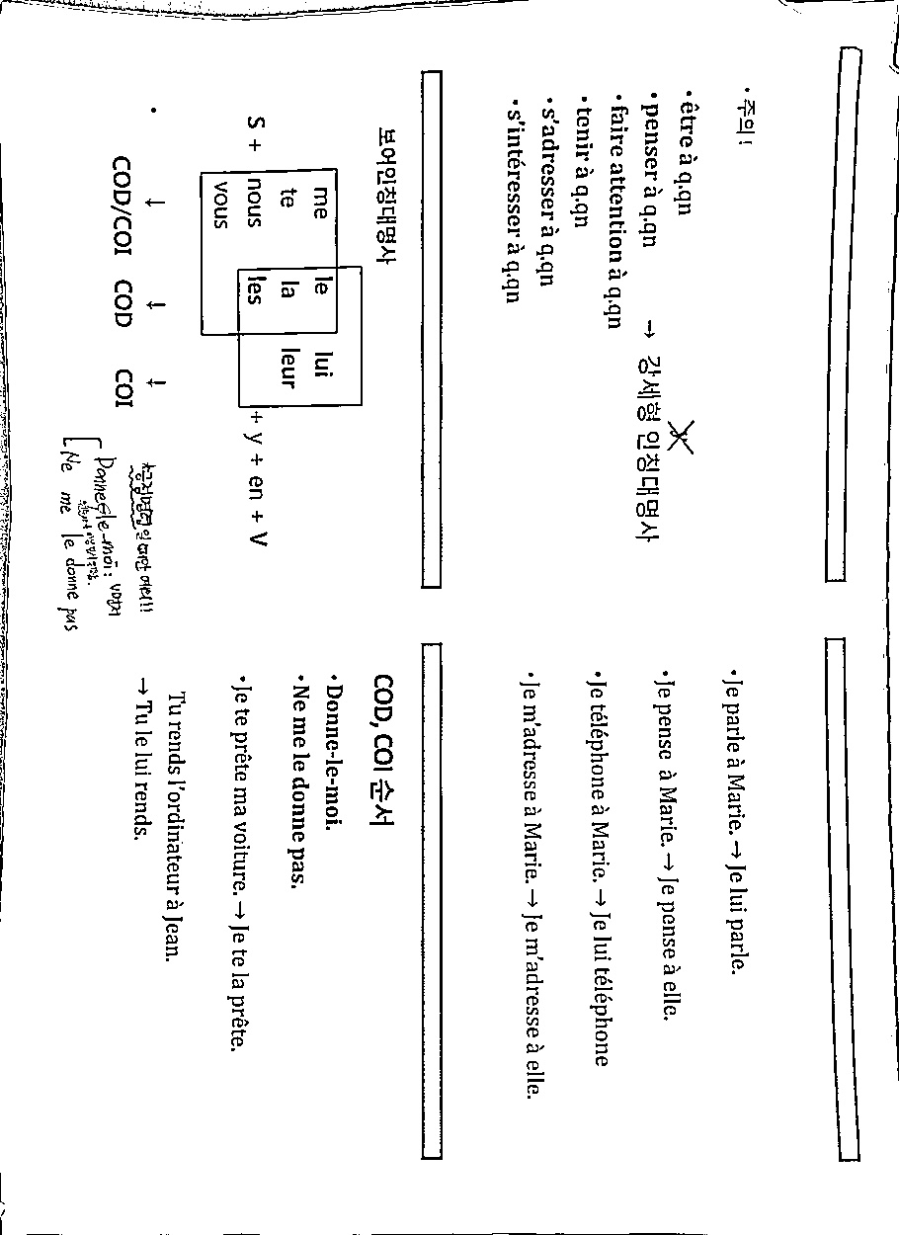
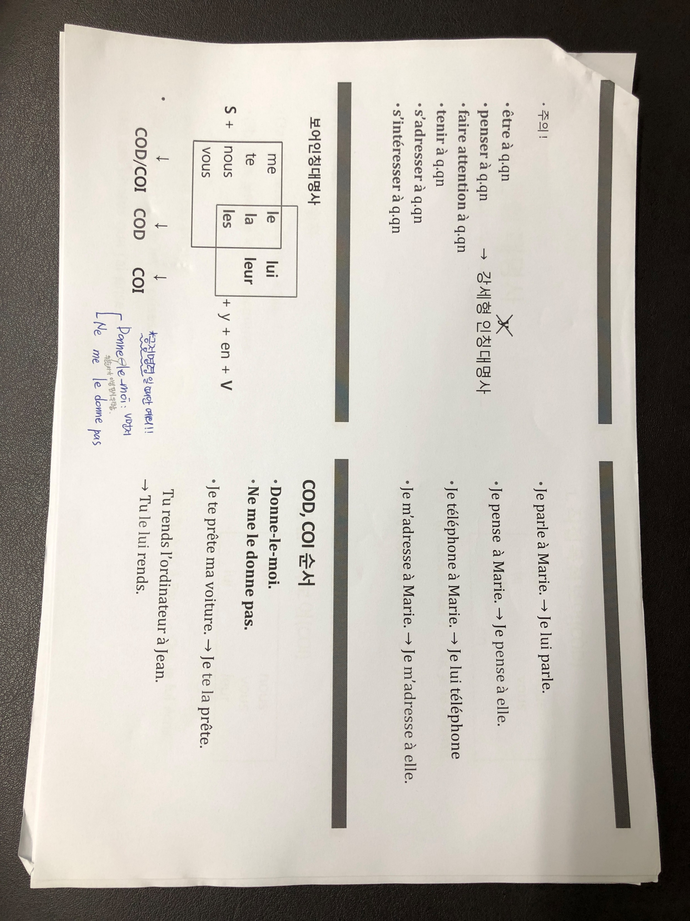
Results

Slide 20
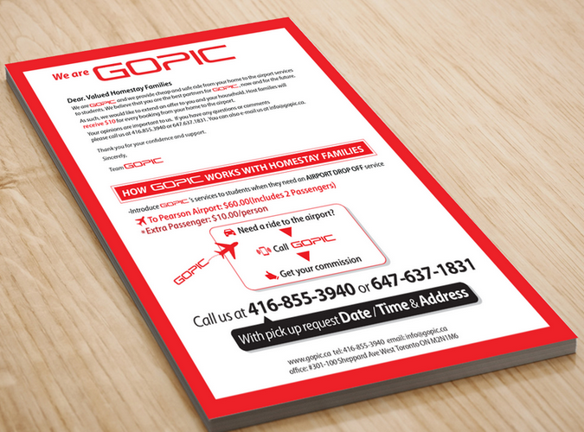

Results

Slide 21
Thank You

